Slide 1
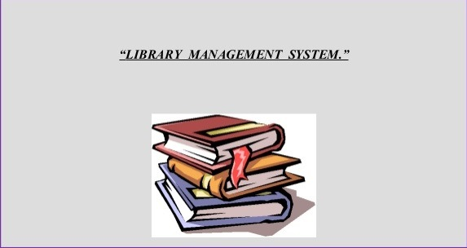

Slide 2
LIBRARY MANAGEMENT SYSTEM
Team– 1
Abhilasha S
Komathi K
Sangeeta Yadav
Rohit Kumar

Slide 3
INDEX
Introduction
Problem Statement
Objective
Implementation
Software Requirements
System Implementation

Slide 4
INTRODUCTION
Library Management System is an application which refers to library systems which are generally small or medium in size.
It is used by Librarian to manage the library record various transactions like issue of books, return of books, addition of new books, addition of new students etc.
it provide facilities to student or member to search for the required books and it allows the administrator or librarian to Issue & return books to students and can create & delete membership of students

Slide 5
PROBLEM STATEMENT
Presently, transaction of books in the institutional libraries have been done manually in most cases, thereby taking more time for transaction like borrowing of books or return of books and also searching of member and books.
Series of problems occur as a result of this thereby resulting to inefficient library management.
In most cases as a result of human error there maybe loss and damages of records due to not using a computerized system in the library

Slide 6
OBJECTIVE
General Objective:
The main objective of this project is to develop a computerized system that will manage the activities in the library .
Thereby providing easy access of library usage for librarian and users of the library, it will also help librarians keep track of library information etc.
This system will also provide electronic means of storage and help librarians keep track of library information

Slide 7
Specific Objective :
Designing a computerized library management system which would help evacuate the problem faced in manual library.
Implementing the system.
Evaluating and testing the performance of the system.

Slide 8
IMPLEMENTATION
Functional Requirements:
Following is a list of functionalities of the system.
There are two categories of people who would access the system viz. students & Librarian/Admin.
Students should be able to :
• login to the system using his/her credentials.
• Search for a particular book .
• Borrow book from the library.
• Return book to the library.

Slide 9
The librarian/Admin should be able to :
• login to the system using his/her credentials
• include new books or remove books from the inventory .
• include new users or can remove users from the inventory .
• manage return and issue book operations .

Slide 10
SOFTWARE REQUIREMENTS
Operating System : Windows 10.
Coding Language : JAVA
Tool : Eclipse

Slide 11
SYSTEM IMPLEMENTATION
Admin Login:
After entering to the home page librarian can choose the admin login option where they are asked to enter username and password, and if he/she is a valid user then a login page will be displayed .
LIBRARYMANAGEMET SYSTEM DATABASE
ADMIN LOGIN
PAGE
ENTER USERNAME AND PASSWORD
CHECK VALIDITY
HOMEs
ADMIN LOGIN PAGE

Slide 12
User login : After entering to the home page of the website, user can choose the user login option where they are asked to enter username and password, and if he/she is a valid user then a user login page will be displayed
LIBRARY MANAGEMENT SYSTEM DATABASE
USER LOGIN PAGE
ENTER USERNAME AND PASSWORD
ADMIN DATABASE
HOME
USER LOGIN PAGE

Slide 13
Book search : After the home page login there will be an option of the book search where after entering book detail like author name, book name etc. book details will be displayed .
SELECT SEARCH OPTION
ENTER BOOK DETAIL
HOME
LIBRARY MANAGEMENT SYSTEM
DISPLAY BOOK DETAILS

Slide 14
Book borrow : The book borrow Data Flow Diagram is the one where after entering user login page he/she can select a book borrow option where after entering the book detail, he/she can select the book borrow option.
BORROW BOOK
SEARCH BOOK
HOME
DISPLAY BOOK DETAILS
LIBRARY MANAGEMENT
SYSTEM
DATABASE
LIBRARY MANAGEMET SYSTEM
DATABASE

Slide 15


